Slide 1
Capstone Project Presentation
IBM Professional Data Science Certification
By:
Abhishek Kumar Singh

Slide 2
Content
Introduction
Data Used
Methodology
Results

Slide 3
Introduction
The project analyses the neighborhoods of Toronto to see the prospect of opening a Chinese Restaurant.
The analysis makes use of foursquare apis and machine learning algorithms to come to a valid decision.
We have made use of clustering technique to classify the neighborhoods.

Slide 4
Data used
Following sources will be used to extract the data:
Wikipedia
Geocoder package
Foursquare API to get the details of neighborhood so that proper clustering can be done.

Slide 5
Methodology
Scraping the data from various online sources.
Processing it to transform it into a format fit for analysis.
Group the data based on Neighborhoods.
Use Geospatial data for getting the latitude and longitudes of different neighborhoods.
Use Folium for properly mapping the dataset processed.
With the help of foursquare api’s we get the venue details so that proper familiarization of neighborhoods
can be done.
Apply K-means clustering to segregate the neighborhoods.

Slide 6
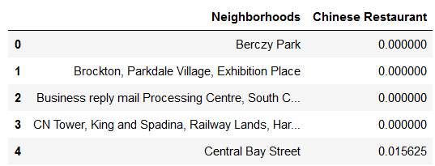
Results
With the help of K-means clustering, we are able to club the neighborhoods with similar features.
Chinese restaurant are hard to find in some regions while in some regions they are in good amount.
We can then make a decision or further we can make analysis of infrastructure of a feasible region and then we can choose the best possible region.

